Slide 1
Data Science Workshop
Guy Azov
Brian Gordon
Shachar Banayan
Tomer Moinian

Slide 2
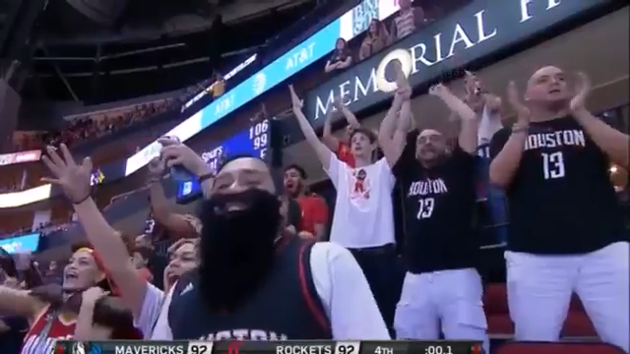

Slide 3

Project Goals
NBA Free Throws Prediction
Main Target: Try to predict whether a player will score a certain free throw (online prediction).
Secondary Target: Predict the players success percentage for the current season based on his past performance and give the coach an insight about the player (offline prediction).

Slide 4
Data Collection
Kaggle imported dataset – ‘NBA Free Throws’
618,019 NBA free-throws (ESPN.com)
11 variables:
12,874 unique games
end_result
game
game_id
period
play
player
playoffs
score
season
shot_made
time

Slide 6
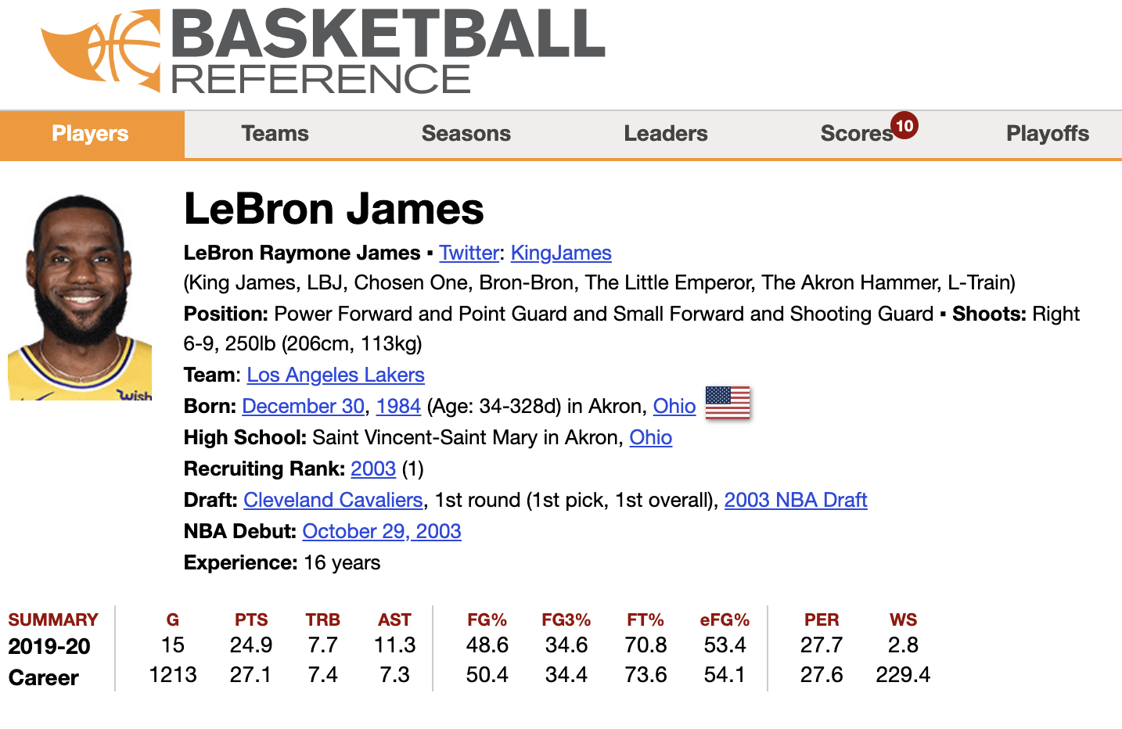
Data Collection
Collecting more data from internet
PandasBasketball library
webscrapper for more players stats
Position
FG%
3P%
FT%
Height
Weight
ShootingHand
draftRank
https://www.basketball-reference.com

Slide 7
Data Understanding
Choosing the relevant columns
Changing position from categorial to numeric
Changing playoff and Shooting Hand to binary
Filling NA cells
Analyzing correlations:
draft rank and free-throw result
score difference and free-throw result
position and free-throw success percentage.

Slide 8
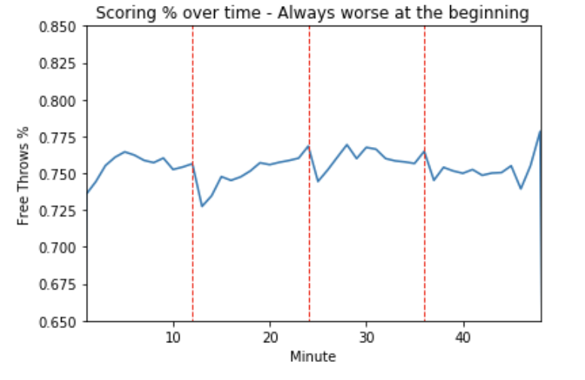
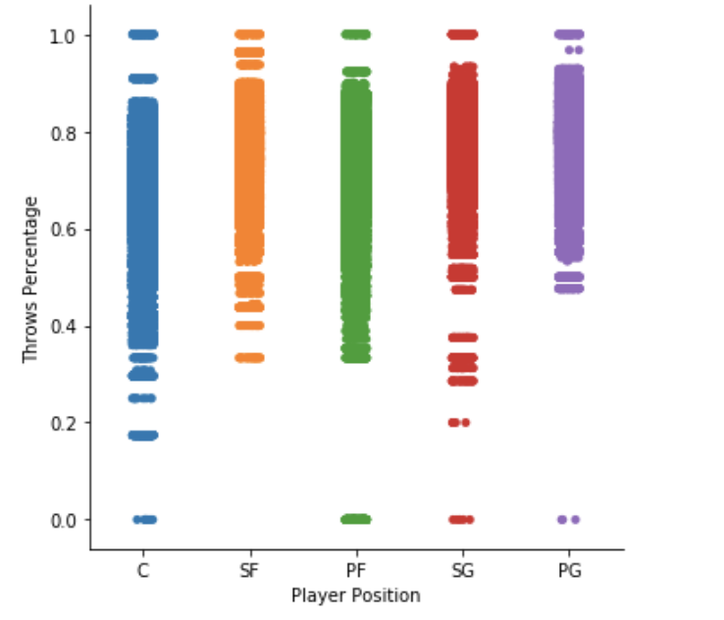
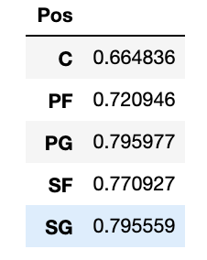
Data Visualization

Slide 9
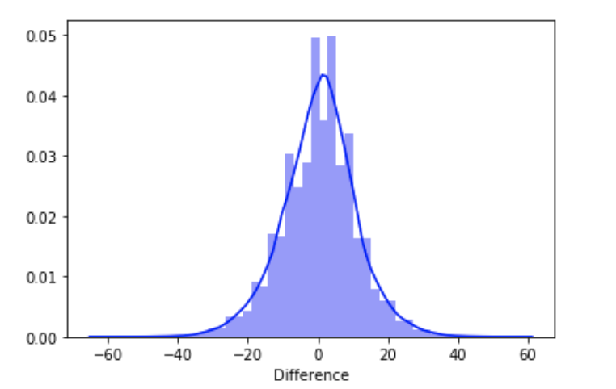
Data Visualization

Slide 10
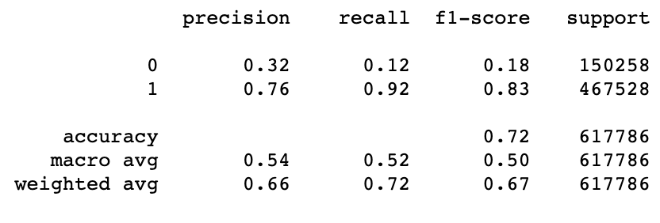
Baseline Model
Model without learning
Prediction based only on FT%
Threshold classification, FT% > 0.5 predicted as shot made, else missed.
Performance:

Slide 11
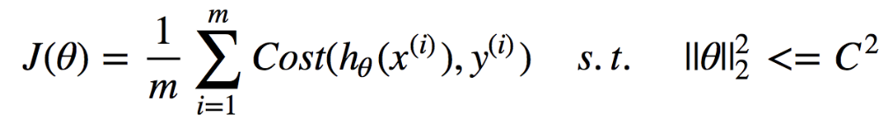
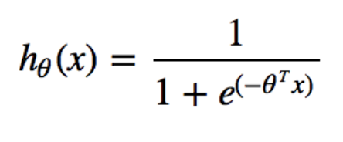
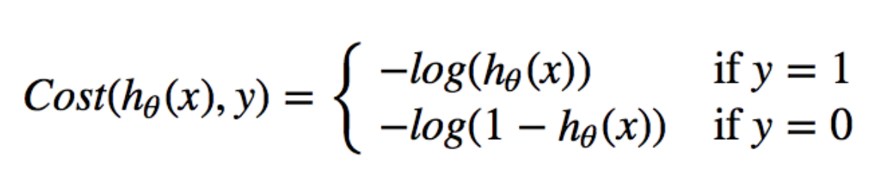
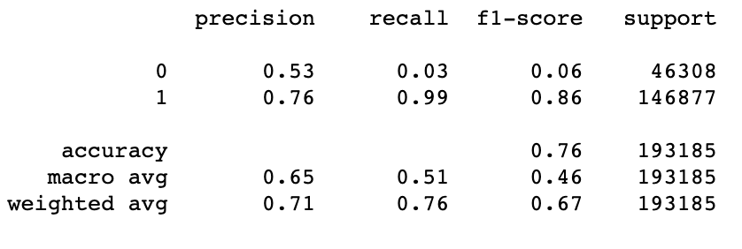
Log-Regression Model
Logistic Regression model loss function:
Performance:

Slide 12
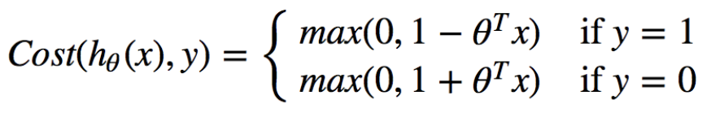
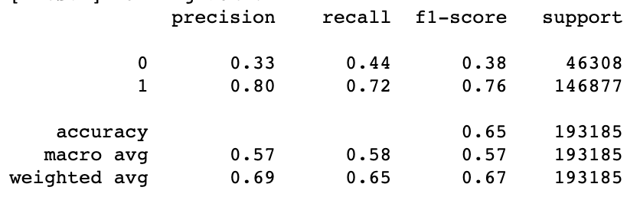
Linear SVM Model
Linear SVM model loss function:
Performance:

Slide 13
What’s next?
Fine tuning on hyper-parameters on Log-Regression and linear SVM models.
Try different kernels on SVM models (rbf or polynomial)
Use different models for data classification as Neural Nets & Random Forest.
Attack the unbalanced labels problem with different loss functions.

